Slide 1
CSE413 – Security of Information Systems 2020 PhD Furkan Gözükara, Toros University https://github.com/FurkanGozukara/Security-of-Information-Systems-CSE413-2020
Lecture 8
User Authentication
Composed from Prof. Audun Jøsang, University of Oslo, Information Security 2018 Lectures
Source : https://www.uio.no/studier/emner/matnat/ifi/INF3510/v18/lectures/

Slide 2
Outline
Context of user authentication
Identity and authentication steps
User Authentication
Knowledge-Based Authentication
Passwords
Ownership-Based Authentication
Tokens
Inherence-Based Authentication
Biometrics
Authentication frameworks for e-Government
2

Slide 3




Taxonomy of Authentication
Authentication
This lecture
Entity Authentication
Data Authentication
MAC,
DigSig&PKI
User
Authentication
Organisation
Authentication
System
Authentication
passwords, tokens,
OTP, biometrics
crypto protocols,
e.g. TLS, PKI
crypto protocols,
e.g. IPSec, PKI
3

Slide 4
Identity and Access Management (IAM) Phases
Configuration
phase
Operation phase
Registration of identity
Self- Identification
Claim identity
This lecture
Provisioning of credentials
Authentication
Prove claimed identity
Enforce access authorization policy
Authorization of access
Access control
4

Slide 5
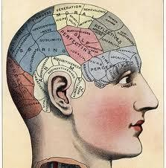
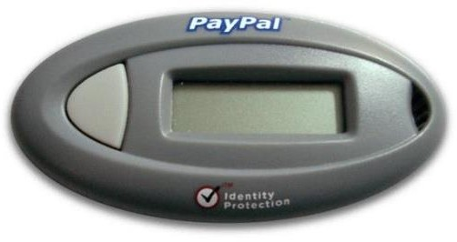
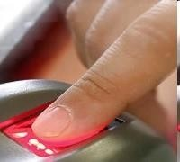
User authentication credentials
A credential is the ‘thing’ used for authentication.
Credential categories:
Knowledge-Based (Something you know): Passwords
Ownership-Based (Something you have): Tokens
Inherence-Based (Something you are/do): Biometrics
physiological biometric characteristics
behavioural biometric characteristics
Combinations, called multi-factor authentication
5

Slide 6
Knowledge-Based Authentication
Something you know: Passwords
6

Slide 7
Authentication: Static passwords
123456
Passwords are a simple and the most common authentication credential.
Something the user knows
Problems:
Easy to share (intentionally or not)
Easy to forget
Often easy to guess (weak passwords)
Can be written down (both good and bad)
If written down, then “what you know” is “where to find it”
Often remains in computer memory and cache
7

Slide 8
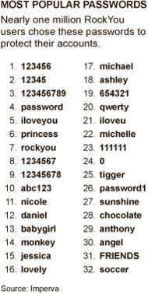
RockYou Hack
32 million cleartext passwords stolen from RockYou database in 2009
Posted on the Internet
Contains accounts and passwords for websites
MySpace, Yahoo, Hotmail
Analyzed by Imperva.com
– 1% use 123456
20% use password from set of 5000 different passwords
INF3510 - UiO 201
8 8

Slide 9
Secure password strategies
Passwords length ≥ 13 characters
Use ≥ 3 categories of characters
L-case, U-case, numbers, special characters
Do not use ordinary words (names, dictionary wds.)
Change typically every 3 − 13 months
OK to reuse between low-sensitivity accounts
Do not reuse between high-sensitivity accounts
Store passwords securely
In brain memory
On paper, adequately protected
In cleartext on offline digital device, adequately protected
Encrypted on online digital device
9

Slide 10
Strategies for strong passwords
User education and policies
Not necessarily with strict enforcement
Proactive password checking
User selects a potential password which is tested
Weak passwords are not accepted
Reactive password checking
SysAdmin periodically runs password cracking tool (also used by attackers) to detect weak passwords that must be replaced.
Computer-generated passwords
Random passwords are strong but difficult to remember
FIPS PUB 181 http://www.itl.nist.gov/fipspubs/fip181.htm specifies
automated pronounceable password generator
10

Slide 11
Password storage in OS
/etc/shadow is the file where modern Linux/Unix stores it passwords
Earlier version stored it in /etc/passwd
Need root access to modify it
\windows\system32\config\sam is the file Windows system normally stores its passwords
Undocumented binary format
Need to be Administrator to access it
Network environments store passwords centrally
AD (Active Directory) on Windows servers
LDAP (Lightweight Directory Access Protocol) on Linux
11

Slide 12
Prevent exposure of password file
Systems verify user passwords against stored values in the password file
Password file must be available to OS
This file need protection from users and applications
Avoid offline dictionary attacks
Protection measures
Access control (only accessible by Root/Admin)
Hashing or encryption
In case a password file gets stolen, then hashing/encryption provides a level of protection
12

Slide 13

Hash functions
One-way function
Collision free
any size input
M
M
M´
easy
computation
difficult to
inverse
difficult to find different input values producing same hash
fixed size hash
h(M)
h(M)
A hash function is easy to compute but hard to invert.
Passwords can be stored as hash values.
Authentication function first computes hash of received password, then compares against stored hash value
13

Slide 14
Cracking passwords
Brute Force
Trying all possible combinations
Intelligent search
User name
Name of friends/relatives
Phone number
Birth dates
Dictionary attack
Try all words from an dictionary
Precomputed hashes: Rainbow tables
14

Slide 15

Hash table and rainbow table attacks
Attackers can compute and store hash values for all possible passwords up to a certain length
A list of password hashes is a hash table
A compressed hash table is a rainbow table
Comparing and finding matches between hashed passwords and hash/rainbow table is the method to determine cleartext passwords.
15

Slide 16

Password salting:
Defence against password cracking
Prepend or append random data (salt) to a user’s password before hashing
In Unix: a randomly chosen integer from 0 to 4095.
Different salt for each user
Produces different hashes for equal passwords
Prevents that users with identical passwords get the same password hash value
Increases the amount of work required for hash table attacks and rainbow table attacks
16

Slide 17






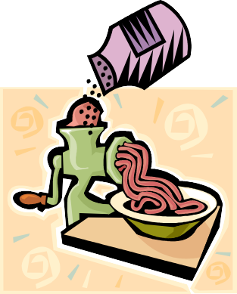


Storing and checking passwords
MyPass
Cleartext
→ Bad security
= ?
Cleartext password database
My Pass
MyPass
MyPass
Hashing
b974db
=?
Hashed password database
Hash
→ Moderate security
b974db
MyPass
Hashing
1736f1
=?
Salted &
hashed password database
Salted hash
→ Good security
Salt
1736f1
17

Slide 18
Problems with using passwords in the clear
A password sent “in clear” can be captured during transmission, so an attacker may reuse it.
An attacker setting up a fake server can get the password from the user
E.g. phishing attack.
Solutions to these problems include:
Encrypted communication channel
One-time passwords (token-based authentication)
Challenge-response protocols
18

Slide 19


HTTP Digest Authentication
A simple challenge-response protocol (rarely used)
A simple challenge response protocol specified in RFC 2069
Server sends:
WWW-Authenticate = Digest
realm=“service domain”
nonce=“some random number”
User types Id and password in browser window
Browser produces a password digest from nonce, Id and
password using a 1-way hash function
Browser sends Id and digest to server that validates digest
1 request access to webpage
3
password
[www-authenticate, domain, nonce]
2
4
[domain, Id, digest = h(nonce, Id, password)]
user
server
19

Slide 20
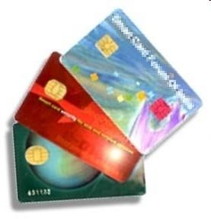
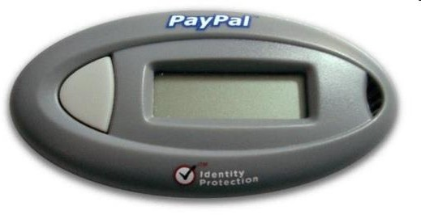
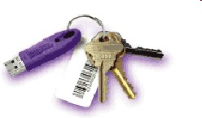
Ownership-Based Authentication
Something you have: Tokens

Slide 21
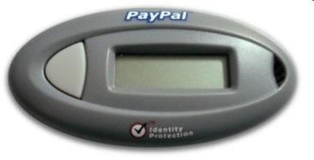
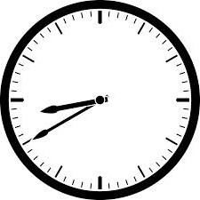
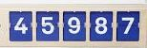
Taxonomy of Authentication Tokens
Authentication
Tokens
? !
Synchronised Tokens
Challenge-Response Tokens
Clock-Based Tokens
Counter-Based Tokens

Slide 22
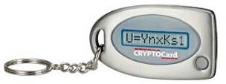
Synchronised OTP (One-Time-Password) Generator
Using a password only once significantly strengthens the strength of user authentication.
Synchronized password generators produce the same sequence of random passwords both in the token and at the host system.
OTP is ‘something you have’ because generated by token
There are two general methods:
Clock-based tokens
Counter-based tokens

Slide 23
Clock-based OTP Tokens: Operation
Token displays time-dependent code on display
– User copies code from token to terminal to log in
Possession of the token is necessary to know the correct value for the current time
Each code computed for specific time window
Codes from adjacent time windows are accepted
Clocks must be synchronised
Example: BankID and SecurID

Slide 24
Clock-based OTP Token Operation with (optional) input PIN
Diagram
USER’S TOKEN
HOST
user id
clock
clock
user id
Secret key
algorithm
Secret key
OTP
Optional PIN
OTP
algorithm
=?
compare
PIN
Optional user input

Slide 25
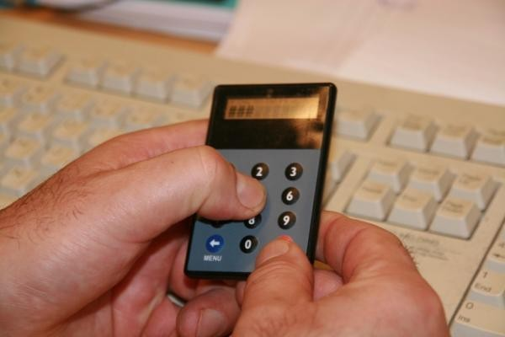
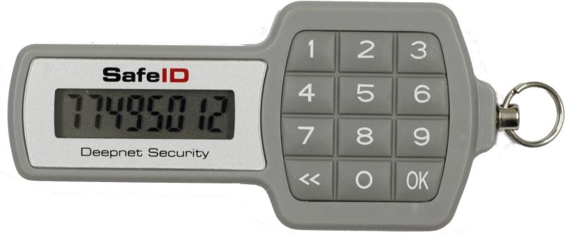
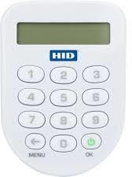
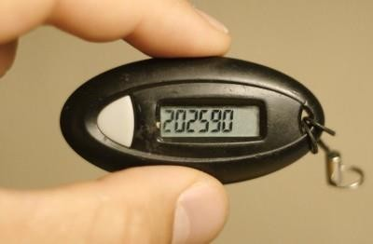
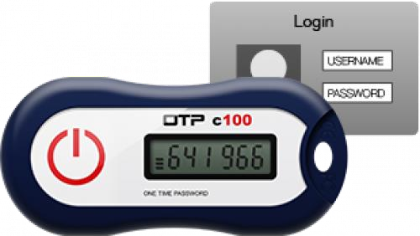
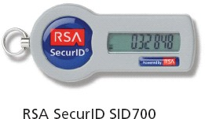
Clock-based OTP Tokens:
SafeID OTP
token with PIN
ActiveID OTP token with PIN
BankID OTP token with PIN
RSA SecurID without PIN
Feitan OTP token witout PIN
BankID OTP token
without PIN

Slide 26
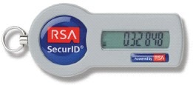
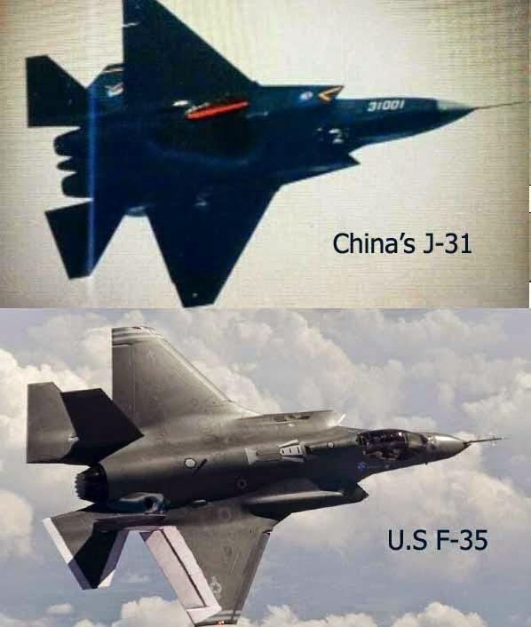
Hacking OTP Tokens
RSA was hacked in 2007.
Secret key for OTP tokens stolen
Hackers could generate OTP and spoof users
Companies using RSA SecureID were vulnerable
Lockheed Martin used RSA SecureID
Chinese attackers spoofed Lockheed Martin staff
– Stole plans for F-35 fighter jet

Slide 27
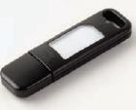
Counter-based OTP Tokens: Overview
Counter-based tokens generate a ‘password’ result value as a function of an internal counter and other internal data, without external inputs.
HOTP is a HMAC-Based One-Time Password Algorithm described in RFC 4226 (Dec 2005)
http://www.rfc-archive.org/getrfc.php?rfc=4226
Tokens that do not support any numeric input
The value displayed on the token is designed to be
easily read and entered by the user.
Reflex 530

Slide 28
Counter-based OTP Token Operation
Diagram
USER’S TOKEN
HOST
counter
user id
counter
user id
Secret key
algorithm
Secret key
OTP
OTP
algorithm
=?
compare

Slide 29
? !
Challenge Response Based Tokens for User Authentication:
A challenge is sent in response to access request
A legitimate user can respond to the challenge by performing a task which requires use of information only available to the user (and possibly the host)
User sends the response to the host
Access is approved if response is as expected by host.
Advantage: Since the challenge will be different each time, the response will be too – the dialogue can not be captured and used at a later time
Could use symmetric or asymmetric crypto

Slide 30
? !
Token-based User authentication Challenge Response Systems
HOST
TOKEN
Id / key
Id / key
challenge
Random number generator
encrypt
encrypt
Optional display
=?
compare
response
Symmetric algorithm case

Slide 31

? !
Contactless Cards: Overview
Contactless cards, also called RFID (Radio Frequency Id) cards, consists of a chip and an antenna.
No need to be in physical contact with
the reader.
Uses radio signals to communicate
Powered by magnetic field from reader
When not within the range of a reader
it is not powered and remains inactive.
Battery powered RFID tags also exist
Suitable for use in hot, dirty, damp, cold, foggy environments
RFID Card
Computer chip
Antenna

Slide 32
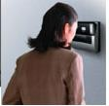

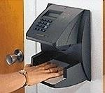
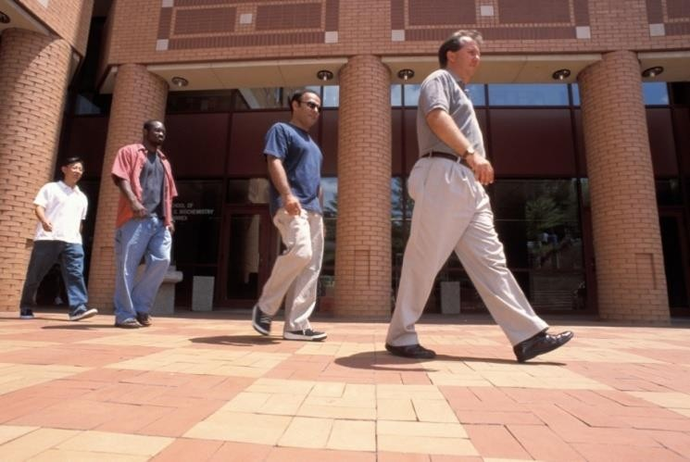
Inherence-Based Authentication
Biometrics
Something you are
Something you do

Slide 33
Biometrics: Overview
What is it?
Automated methods of verifying or recognizing a person based upon a physiological characteristics.
Biometric modalities, examples:
fingerprint
facial recognition
eye retina/iris scanning
hand geometry
written signature
voice print
keystroke dynamics

Slide 34
Biometrics: Requirements
Universality:
Each person should have the characteristic;
Distinctiveness:
Any two persons should be sufficiently different in terms of the characteristic;
Permanence:
The characteristic should be sufficiently invariant (with respect to the matching criterion) over a period of time;
Collectability:
The characteristic should be measurable quantitatively.

Slide 35
Biometrics: Practical considerations
Accuracy:
The correctness of a biometric system, expressed as ERR (Equal Error Rate), where a low ERR is desirable.
Performance:
the achievable speed of analysis,
the resources required to achieve the desired speed,
Acceptability:
the extent to which people are willing to accept the use of
a particular biometric identifier (characteristic)
Circumvention resistance:
The difficulty of fooling the biometric system
Safety:
Whether the biometric system is safe to use

Slide 36
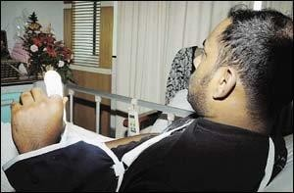
Biometrics Safety
Biometric authentication can be safety risk
Attackers might want to “steal” body parts
Subjects can be put under duress to produce biometric authenticator
Necessary to consider the physical environment where biometric authentication takes place.
Car thieves chopped off part of the driver’s left index finger to start S-Class Mercedes Benz equipped with fingerprint key.
Malaysia, March 2005
(NST picture by Mohd Said Samad)

Slide 37
Biometrics: Modes of operation
Enrolment:
analog capture of the user’s biometric attribute.
processing of this captured data to develop a template of the user’s attribute which is stored for later use.
Identification (1:N, one-to-many)
capture of a new biometric sample.
search the database of stored templates for a match based solely on the biometric.
Verification of claimed identity (1:1, one-to-one):
capture of a new biometric sample.
comparison of the new sample with that of the user’s stored template.

Slide 38


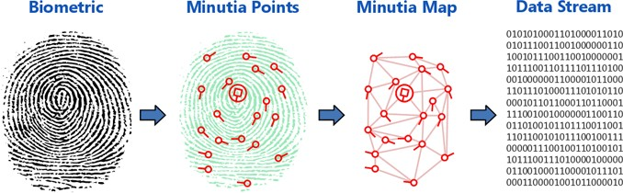
Extracting biometric features
Example fingerprints: Extracting minutia
Bifurcation
Ridge ending

Slide 39


Biometrics:
System components
System Database
System Components
Sensor
Feature Extractor
Matcher

Slide 40
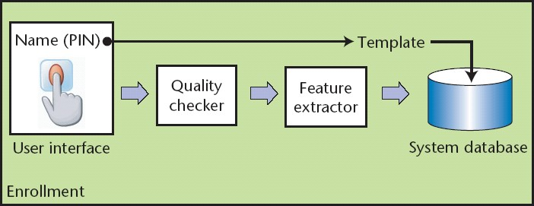
Biometrics: Enrolment
Biometric Recognition: Security and Privacy Concerns

Slide 41
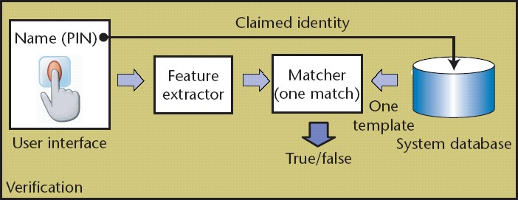
Biometrics: Verification
Biometric Recognition: Security and Privacy Concerns

Slide 42
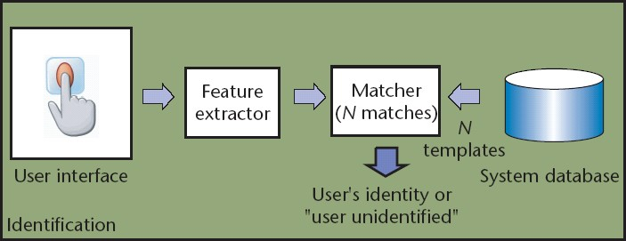
Biometrics: Identification
Biometric Recognition: Security and Privacy Concerns

Slide 43
Evaluating Biometrics:
Features from captured sample are compared against those of the stored template sample
Score s is derived from the comparison.
Better match leads to higher score.
The system decision is tuned by threshold T:
System gives a match (same person) when the sample comparison generates a score s where s ≥T
System gives non-match (different person) when the sample comparison generates a score s where s < T

Slide 44
Matching algorithm characteristics
True positive
User’s sample matches → User is accepted
True negative
Stranger’s sample does not match → Stranger is rejected
False positives
Stranger’s sample matches → Stranger is accepted
False negatives
User’s sample does not match → User is rejected
False Match Rate and False Non-Match Rate
FMR = (# matching stranger samples) / (total # stranger samples) FNMR = (# non-matching user samples) / (total # user samples)
T determines tradeoff between FMR and FNMR

Slide 45
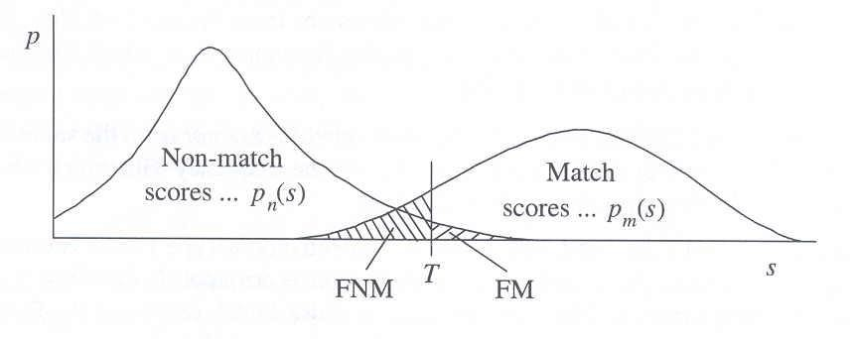
Evaluating Biometrics: System Errors
Comparing biometric samples produces score s
Acceptance threshold T determines FMR and FNMR
If T is set low to make the system more tolerant to input variations and noise, then FMR increases.
On the other hand, if T is set high to make the system more secure, then FNMR increases accordingly.
EER (Equal Error Rate) is the rate when FMR = FNMR.
Low EER is good.
Stranger score distribution
User score distribution
FNMR
FMR
45

Slide 46
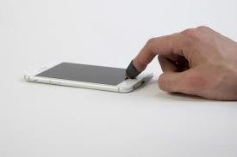

Spoofing Biometrics: Presentation Attacks
It is relatively simple to trick a biometric system
Terminology: Presentation Attacks
False finger
False face
Biometric authentication on smartphones is insecure
PAD (Presentation Attack Detection) is the subject of intensive research, to make biometrics more secure
Alternative solution is to capture biometrics in controlled environments

Slide 47
Authentication: Multi-factor
Multi-factor authentication aims to combine two or more authentication techniques in order to provide stronger authentication assurance.
Two-factor authentication is typically based on something a user knows (factor one) plus something the user has (factor two).
Usually this involves combining the use of a password and a token
Example: BankID OTP token with PIN + static password

Slide 48

Authentication Assurance
Authentication assurance = robustness of authentication
Resources have different sensitivity levels
High sensitivity gives high risk in case of authentication failure
Authentication has a cost
Unnecessary authentication assurance is a waste of money
Authentication assurance should balance resource sensitivity
AAL
Required User Authentication Assurance
Level
Authentication Risk

Slide 49
e-Authentication Frameworks for e-Gov.
Trust in identity is a requirement for e-Government
Authentication assurance produces identity trust.
Authentication depends on technology, policy, standards, practice, awareness and regulation.
Consistent frameworks allow cross-national and cross-organisational schemes that enable convenience, efficiency and cost savings.

Slide 50
Alignment of e-Authentication Frameworks
Authentication Framework | User Authentication Assurance Levels
NIST SP800-63-3 USA 2017 |  |  | Some (1) | High (2) | Very High (3)
eIDAS EU 2014 |  |  | Low (1) | Substantial (2) | High (3)
ISO 29115 ISO/IEC 2013 | Low (Little or no) (1) |  | Medium (2) | High (3) | Very High (4)
e-Pramaan India 2012 | None (0) | Minimal (1) | Minor (2) | Significant (3) | Substantial (4)
NeAF Australia 2009 | None (0) | Minimal (1) | Low (2) | Moderate (3) | High (4)
RAU / FAD Norway 2008 | Little or no assurance (1) |  | Low (2) | Moderate (3) | High (4)

Slide 51
AAL: Authentication Assurance Level
AAL is determined by the weakest of three links:
Requirements for correct registration:
Pre-authentication credentials, e.g.
birth certificate
biometrics
User Identity Registration Assurance
(UIRA) requirements
Requirements for secure
handling of credentials:
Creation
Distribution
Storage
Requirements for mechanism strength:
Password length and quality
Cryptographic algorithm strength
Tamper resistance of token
Multiple-factor methods
User Credential Management Assurance
(UCMA) requirements
User Authentication Method Strength
(UAMS) requirements

Slide 52

eIDAS
electronic IDentification, Authentication and trust Services
eIDAS is EU’s regulation on e-Authentication and trust services for e-transactions.
“Trust service” is EU jargon for PKI
certification services.
eIDAS specifies three authentication assurance levels (AALs).
The EU trust mark for qualified trust services
Low Assurance eDAS AAL-1 | Substantial Assurance eIDAS AAL-2 | High Assurance eIDAS AAL-3
Limited degree of confidence in the claimed or asserted identity of a person | substantial degree of confidence in the claimed or asserted identity of a person | higher degree of confidence in the claimed or asserted identity of a person

Slide 53
Risk Analysis for eAuthentication
Determining the appropriate AAL for an application
 | Impact of e-Authentication Failure
 | Minor | Moderate | Major
Required AAL → | Low eIDAS AAL-1 | Substantial eIDAS AAL-2 | High eIDAS AAL-3
E-Authentication Failure means that an imposter is able to
attack and steal somebody else’s identity
Example risk matrix applied to eIDAS

Slide 54
RAU Norway 2008
Rammeverk for Autentisering og Uavviselighet (Framework for Authentication and Non-Repudiation)
RAU AAL-4: High authentication assurance
E.g. two-factor, where at least one must be dynamic, and at least one is
provisioned in person
RAU AAL-3: Moderate authentication assurance
E.g. OTP calculator with PIN provisioned by mail to user’s official address
RAU AAL-2: Low authentication assurance
E.g. fixed password provisioned in person or by mail to user’s official address
RAU AAL-1: Little or no authentication assurance :
E.g. Online self-registration and self-chosen password
Norway will adopt eIDAS in 2018 (RAU will no longer be used)

Slide 55
Only Three AALs in Modern eAuth. Frameworks
Early eAuthentication frameworks typically had four AALs
In practice the very low AAL is not used
Very low AAL is inadequate for Cross-border/Federated auth.
eIDAS assumes cross-border authentication
NIST SP800-63-3 assumes federated authentication
Current providers of highest AAL (RAU AAL-4) in Norway
Commfides
Buypass
BankID
BankID på mobil
Adoption of eIDAS in Norway will probably be relatively simple
Some authentication service providers may need to make changes to keep accreditation for the highest AAL (eIDAS AAL-3)

Slide 56
End of lecture

